Slide 1

Fraud Detection System
BCA - ( AI & DS ) – ‘A’

Slide 2
Leveraging Machine Learning for Secure Financial Transactions
Team Members:
JAKINBA J
AARINTHARA BABU D
MANI KANDAN S

Slide 3
Introduction to the Project
Objective:
Develop a system to predict fraudulent financial transactions.
Enhance financial security and prevent fraudulent activities.
Problem Statement:
Financial fraud is a growing issue.
Existing systems lack real-time prediction capabilities.
Solution:
Machine Learning-based classification model integrated into a web application.

Slide 4
Key Features of the Project
Real-time transaction analysis.
User-friendly web interface built using Flask.
Accurate classification model achieving >70% accuracy.
Supports diverse transaction inputs: amount, location, purchase type.

Slide 5
Algorithm/Process of the Project
Workflow Overview:
Data Collection: Using `FDS.csv`.
Data Preprocessing: Encoding categorical features.
Model Training: Random Forest algorithm.
Web Application Development: Flask-based app.
Prediction: Real-time classification of transactions.

Slide 6
Technologys Used
Programming Language:
Python
Libraries:
Scikit-learn, Flask, Pickle
Tools:
VS Code, Jupyter Notebook
Web Framework:
Flask

Slide 7
ML/AI Algorithm Used
Algorithm:
Random Forest Classifier
Key Characteristics:
Ensemble learning method.
Reduces overfitting and improves accuracy.
Handles numerical and categorical data efficiently.

Slide 8
Why Random Forest?
High accuracy and robustness.
Ranks feature importance.
Implementation Steps:
Trained on cleaned data.
Saved model as `model.pkl`.
Encoded inputs using label encoders

Slide 9
Output and Results
Web Interface:
Input transaction details (amount, location, purchase type).
Prediction Results:
`Fraud` or `Not Fraud` displayed.
Accuracy:
Model achieved >70% accuracy.
Debugging:
Managed unseen categories in input fields.

Slide 10
Challenges Faced
Data Quality:
Ensuring cleaned and balanced data.
Handling Unseen Inputs:
Managing unknown locations or purchase types.
Deployment:
Seamless model integration with Flask

Slide 11
Conclusion
Key Takeaways:
Built a classification model to detect fraudulent transactions.
Delivered a functional web application.
Achievements:
Accuracy above 70%.
Robust and scalable system.
Applications:
Deployed in financial institutions to prevent fraud.
Extendable to real-time systems.

Slide 12
Future Outcomes
Next Steps:
Improve performance using advanced algorithms like XGBoost.
Expand dataset to include global transaction patterns.
Develop real-time data processing pipelines.
Add features like user authentication and anomaly detection.
Vision:
Scalable, real-time fraud detection system for global deployment.

Slide 13
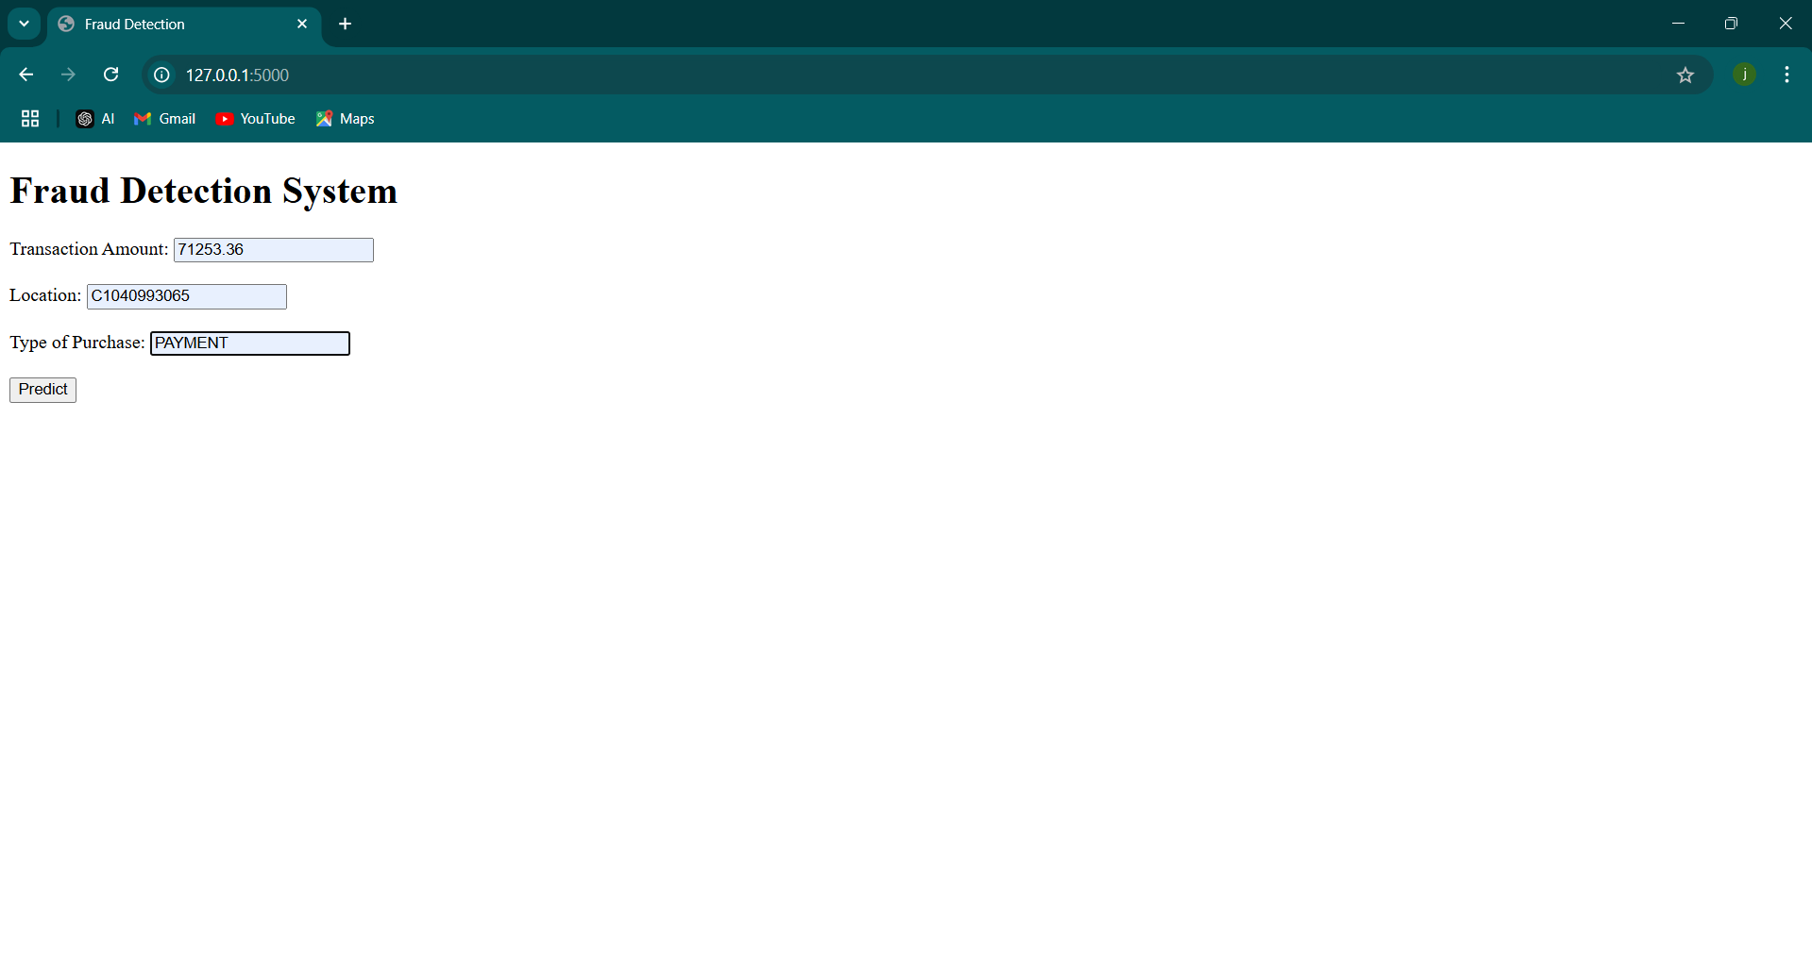
Execution of the project

Slide 14
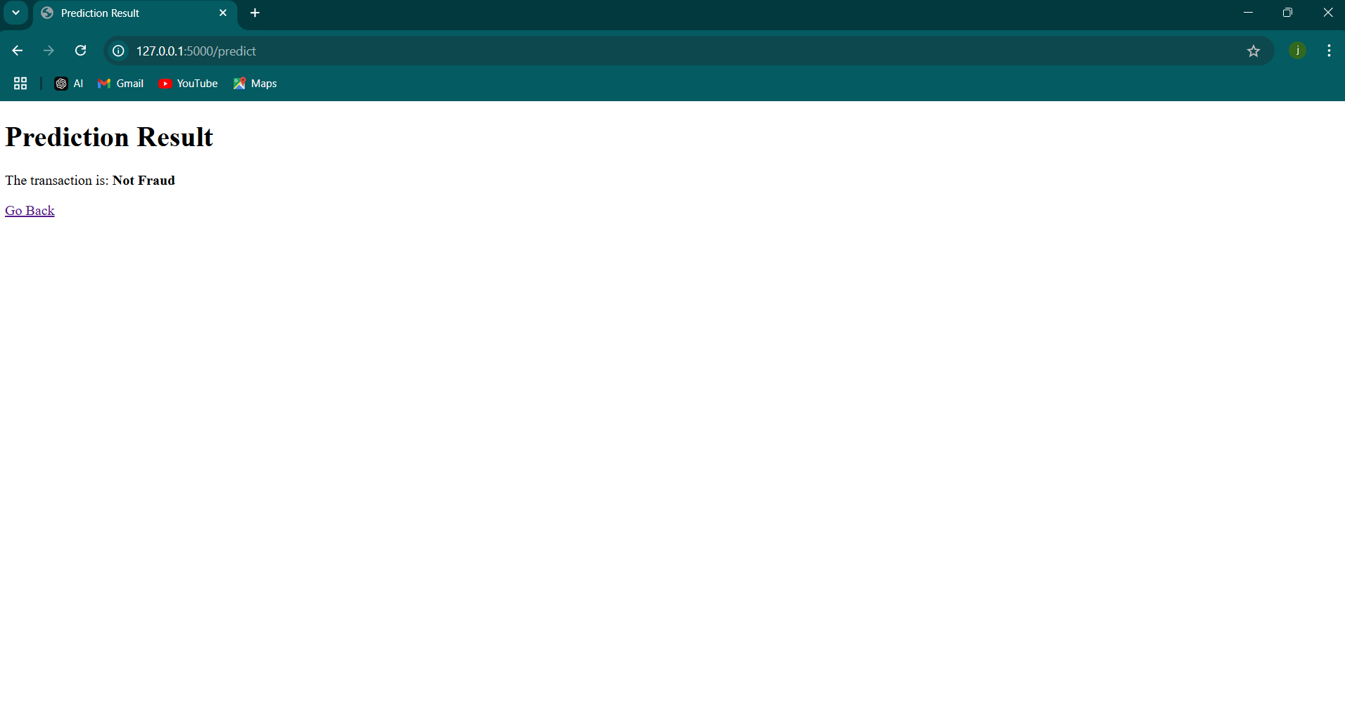
Output of the project

Slide 15
Thank you
Contact info: thingstoknow4509@gmail.com

